Slide 1
AEI.org/housing | December 17, 2024
How Light-Touch Density and Livable Urban Villages Can Initiate the Housing Abundance Sequence in Virginia
Edward Pinto
Co-Director and Senior Fellow
(Edward.Pinto@aei.org)
I grant permission to reuse this presentation, as long as you cite as the source:
AEI Housing Center, www.aei.org/housing.
Link to AEI Housing Market Indicators:
https://www.aei.org/housing/housing-market-indicators/
Link to AEI Housing and Economic Analysis Toolkit (HEAT):
https://heat.aeihousingcenter.org/toolkit
Link to AEI Housing Center Good Neighbor (GNI) Toolkit
https://aeihousingcenter.org/good_neighbors_toolkit/
Disclosure:
The author has a financial relationship with Places Platform LLC, which is interested in meeting housing supply shortages through walkable oriented development and in the development of metrics for all types of real estate.

Slide 2
Spoiler Alert:
The Virginia Joint Legislative Audit and Review Commission's report to the Legislature contained 18 recommendations:
These recommendations are almost exclusively focused on plans and reports (11), increased housing subsidies (2), and increased inclusionary/income limited housing (4).
The solution requires, not more plans and reports, but rather simple, bold action to unleash the private market’s innate ability to provide housing abundance without top down plans, site-based housing subsidies, income limits, or inclusionary zoning’s cross-subsidies.
"We have to move beyond the narrow, almost futile task of making affordable [subsidized] housing and start working on the broader and more meaningful effort of making housing affordable.“ Charles Marohn, founder of Strongtowns
Today, I will:
Lay out some of the housing supply challenges Virginia faces in order to maintain its future potential for prosperity.
How light-touch density and Livable Urban Villages can ignite Virginia’s Housing Abundance Sequence, and
Outline the key components in Virginia’s Housing Success Playbook.
Virginia’s legislature, governor, and municipalities are at a historic crossroads:
Path 1: Large lot single-family detached = unaffordability and home scarcity
Path 2: Light-touch density and Livable Urban Villages = affordability and home abundance.
In short, the Legislature should consider options to increase zoning density on a wide scale within the state.

Slide 3
To set the stage, consider two thought experiments
Thought experiment #1:
Imagine car manufacturers could only legally build Ferraris. Filtering of new cars down to used ones would be limited as few new cars would be sold, used car prices would sky-rocket, and few could afford either new or used cars.
Instead, new cars are built across a wide range of price points for the broad masses of middle-income buyers, with many costing about $25,000 (i.e. Honda Civics and Toyota Corollas). The result is a broad range of serviceable used cars, so everyone who wants a serviceable car gets one, with no subsidies required.
Thought experiment #2:
Imagine motel/hotel developers could only build Ritz Carltons. Filtering of new rooms down to used ones would be extremely limited as few rooms would be built, existing room rates would sky-rocket, and few could afford to stay.
Instead, new rooms are built across a wide range of price points, yielding a broad range of acceptable room options, so virtually everyone who wants a room gets one, with no subsidies required.
Just think about the variety available at any highway interchange.
Yet zoning, land and construction costs, land use restrictions, financing, and labor availability don’t seem to interfere.
Adding supply at the high end yields few new homes and little move-ups from less expensive housing.
High end housing promoted by exclusionary zoning, government subsidies, so-called inclusionary zoning, and high density transit zones add housing affordable only to a few or require substantial subsidies, with little filtering being triggered.
Adding lots of supply in the middle with light touch density (LTD) reduces supply/demand imbalances and yields a greatly increased number of move-ups from less expensive housing—freeing up those units for filtering down to lower income households.
This market-oriented approach unleashes American ingenuity by swarms of property owners, small businesses, and workers.¹
This yields a large increase of naturally affordable and inclusionary housing.
¹ https://www.strongtowns.org/journal/2021/2/3/unleash-the-swarm
Source: AEI Housing Center, www.AEI.org/housing.

Slide 4
Virginia is facing housing challenges

Slide 5
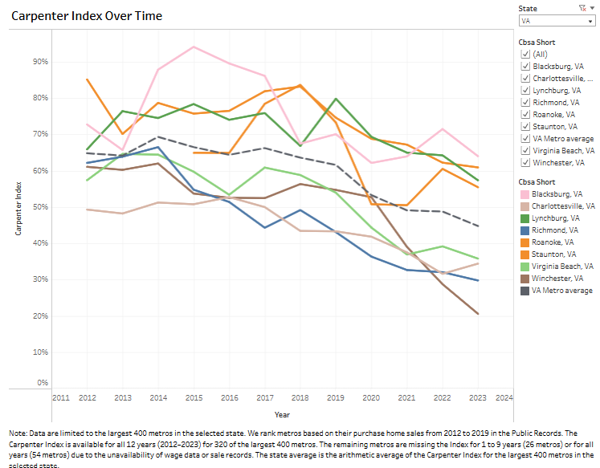
Affordability for Carpenter Households Has Generally Declined Across Virginia’s Largest Metros.* State-wide, 45% Were Able to Purchase the Median Entry-Level Home in 2023, Down from 65% in 2012.**
* Excludes Virginia portion of DC metro.
** Arithmetic averages.
Source: Bureau of Labor Statistics, Public Records, and AEI Housing Center, www.AEI.org/housing.

Slide 6
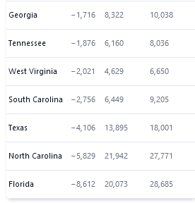
2020-2021: Virginia’s In-Migration (Shown in Green) has been largely from the Northeast, California, and Illinois. Net out-migration has been largely to the South and Texas. Overall, Virginia had net outflow of 6,800 (2020-2021) and 120,000 (2011-2021).
Source: IRS and AEI Housing Center, www.AEI.org/housing.

Slide 7
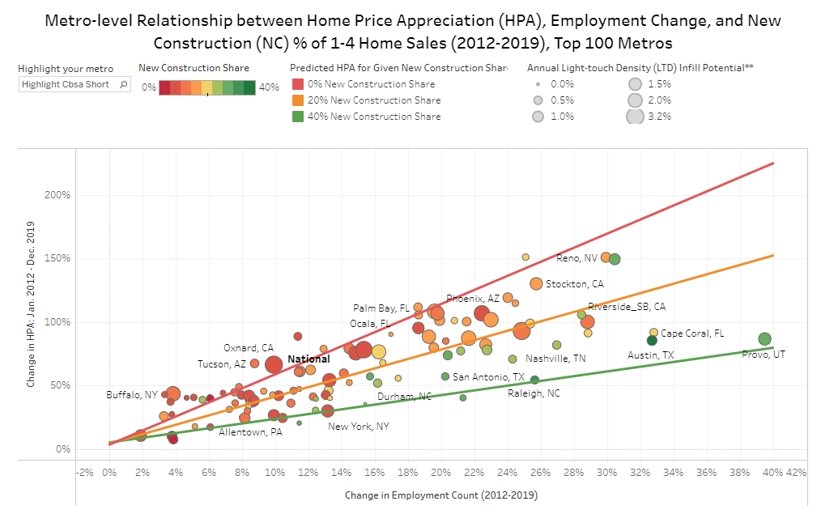
Adding housing supply helps tamp down home price appreciation, especially where jobs are growing rapidly
Home prices appreciate slower in metropolitan regions where high employment growth is combined with high new construction shares of all home sales, thus making homes more naturally affordable.
For its moderate employment growth, Richmond & DC metros are producing homes at levels leading to moderate HPA.
For its low employment growth, Virginia Beach metro is producing homes at a level leading to elevated HPA.
Source: BLS, Freddie, and AEI Housing Center, www.AEI.org/housing.

Slide 8
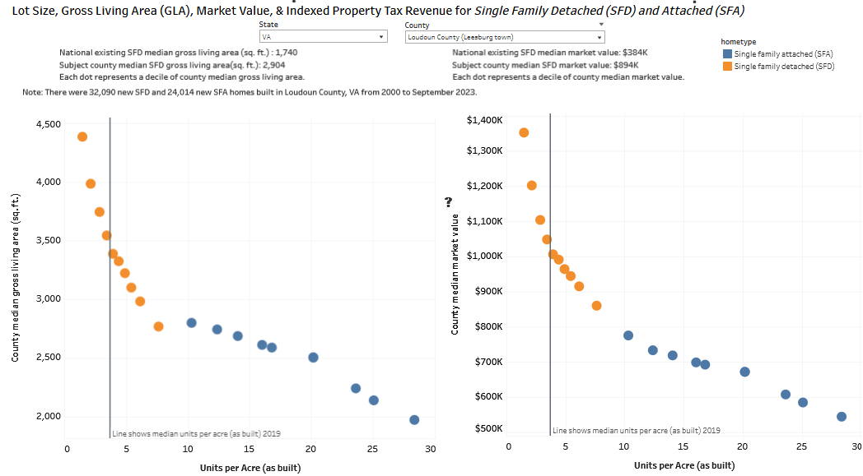
Loudoun Co.: For entry-level and retiree buyers, what is legal to build makes a huge difference
By increasing as built density (units/acre), the gross living area (GLA) & price drop for both single-family detached (SFD) & single-family attached (SFA) homes, unleashing naturally occurring affordable housing (without needing subsidies) & promoting filtering, as lower cost housing is purchased or rented by lower income households.*
Housing abundance requires building new homes near the median price for existing SFD stock (Loudoun Co.: $894k).
10% of new Loudoun County SFD are priced below this median, yet 100% of new SFA are below the median.
Forty percent of Loudoun single-family built since 2000 have been SFA (requiring about 1/4 the land of SFD).
Sprawl and infrastructure costs can be reduced by allowing smaller SFD lots (6-9 homes/acre), and building more duplex/twin homes (8-10/acre), and SFA homes (20-25 home/acre)
* Across 280 counties, these relationships had a correlation of 84% & 60% for SFD & SFA respectively.
Housing and Economic Analysis Toolkit (HEAT): https://heat.aeihousingcenter.org/toolkit

Slide 9
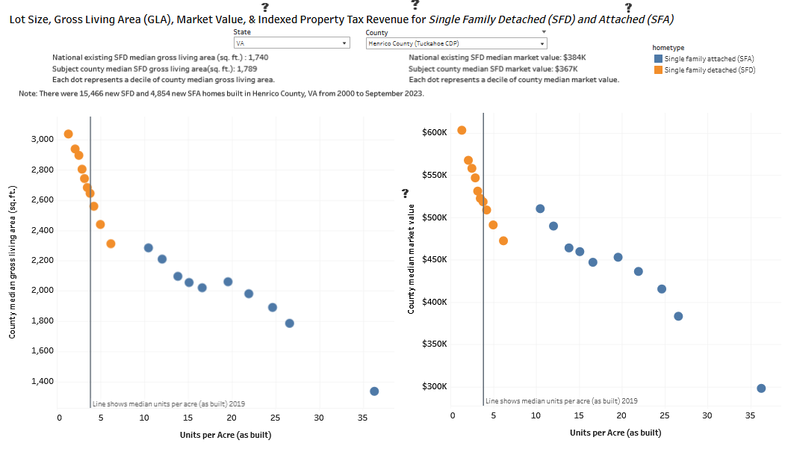
Henrico Co.: For entry-level and retiree buyers, what is legal to build makes a huge difference
By increasing as built density (units/acre), the gross living area (GLA) & price drop for both single-family detached (SFD) & single-family attached (SFA) homes, unleashing naturally occurring affordable housing (without needing subsidies) & promoting filtering, as lower cost housing is purchased or rented by lower income households.*
Housing abundance requires building new homes near the median price for existing SFD stock (Henrico Co.: $367k).
0% of new Henrico Co. SFD are priced below this median, yet 20% of new SFA are below the median.
Twenty-five percent of Henrico Co. single-family built since 2000 have been SFA (requiring about 1/4 the land of SFD).
Sprawl and infrastructure costs can be reduced by allowing smaller SFD lots (6-9 homes/acre), and building more duplex/twin homes (8-10/acre), and SFA homes (20-25 home/acre)
* Across 280 counties, these relationships had a correlation of 84% & 60% for SFD & SFA respectively.
Housing and Economic Analysis Toolkit (HEAT): https://heat.aeihousingcenter.org/toolkit

Slide 10
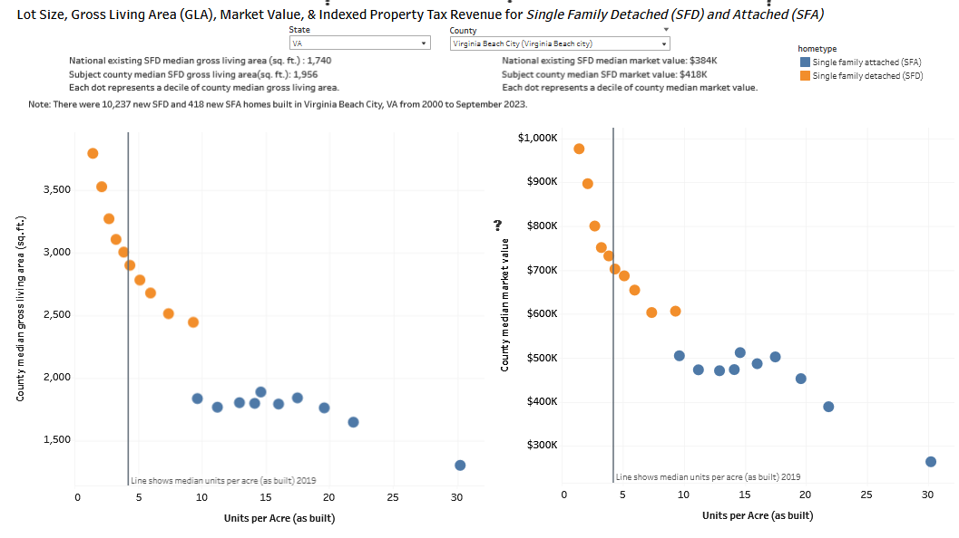
Va Beach City: For entry-level and retiree buyers, what is legal to build makes a huge difference
By increasing as built density (units/acre), the gross living area (GLA) & price drop for both single-family detached (SFD) & single-family attached (SFA) homes, unleashing naturally occurring affordable housing (without needing subsidies) & promoting filtering, as lower cost housing is purchased or rented by lower income households.*
Housing abundance requires building new homes near the median price for existing SFD stock (Va Beach: $418k).
0% of new Va Beach SFD are priced below this median, yet 20% of new SFA are below the median.
Four percent of Va Beach single-family built since 2000 have been SFA (requiring about 1/4 the land of SFD).
Sprawl and infrastructure costs can be reduced by allowing smaller SFD lots (6-9 homes/acre), and building more duplex/twin homes (8-10/acre), and SFA homes (17-25 home/acre)
* Across 280 counties, these relationships had a correlation of 84% & 60% for SFD & SFA respectively.
Housing and Economic Analysis Toolkit (HEAT): https://heat.aeihousingcenter.org/toolkit

Slide 11
How Light-touch Density and Livable Urban Villages Can Ignite Virginia’s Housing Abundance Sequence

Slide 12
Only naturally occurring affordable homes (NOAH), not subsidized housing, can provide the abundant supply necessary to make housing affordable and address Virginia’s affordability crisis
There is an increasing level of broad-based support from organizations like the City Observatory, Sightline Institute, Upjohn Institute, Strongtowns, Vatt Institute, Mercatus Center, Grassroot Institute, and the AEI Housing Center for the position that “building more supply may be the only effective way to reduce the pressure that is driving up rents and producing displacement”.
"We have to move beyond the narrow, almost futile task of making affordable [subsidized] housing and start working on the broader and more meaningful effort of making housing affordable.“ Charles Marohn, founder of Strongtowns
The City Observatory noted that “Sightline Institute has tackled that notion directly. …When there isn’t enough supply, demand from higher income households floods down to older housing stock, driving up rents and reducing housing options for those with lesser means.”
When more such housing is built, older housing becomes more affordable because it speeds up filtering. Filtering is the process where homes tend to be occupied by low-income households as they age and depreciate.* The result is more naturally occurring affordable homes (NOAH).
As has been noted, this concept works for the reasons we can observe this in the other markets, like cars.
The housing market would correct itself if more new homes for middle-income households would be built. This would then allow lower income households to live in older, "used" homes while holding housing costs down.
The solution to housing unaffordability is to legalize by-right light touch density zoning and Livable Urban Villages, and to reduce regulatory barriers and costs.
The result will be the construction of much more NOAH and a speeding up of the natural filtering process.
This can both provide housing to all but the very lowest income levels and create a more economically inclusive housing market.
* Richard Ratcliff, Urban Land Economics, 1949.

Slide 13
LTD is an ideal tool to increase the supply of naturally affordable & inclusionary housing
Light-touch Density (LTD) represents the low-hanging fruit in zoning reform. It is also naturally affordable.
LTD utilizes land in a more efficient way by moderately increasing the density of housing. This reduces sprawl, infrastructure cost, and energy use. Instead of allowing only a single-family detached (SFD) home on a parcel, LTD allows for:
2-8-plexes,
a series of townhouses, or
an accessory dwelling unit (ADU).
LTD also allows for single-family detached homes on smaller lots.
All these LTD options would moderately increase the as-built density of the land, thereby enabling owners and small-scale builders to construct smaller, less expensive units that are more naturally affordable and inclusionary without requiring subsidies.
The LTD type most suitable to each locality depends on the land and construction costs.
For high-cost areas: Tearing down an existing unit and replacing it with townhomes or a 2- to 8-plex.
For medium-cost areas: Adding additional unit(s) (ADU or second home) to an existing parcel.
Everywhere: Increasing the as-built density of new greenfield developments.
These LTD housing types are compatible with single-family detached homes. Since they require less land and are smaller in size, they are more affordable to lower- and middle-income households.
Nationally, LTD has the potential to add up to 900,000 net additional homes per year for the next 30-40 years.*
* These estimates are based on case studies are from Seattle, Charlotte, Houston, Palisades Park, and Tokyo. For a further discussion of Light-touch Density case studies, see pg. 7-10 of the AEI Housing Center booklet on increasing housing supply.
Source: AEI Housing Center, www.AEI.org/housing.

Slide 14
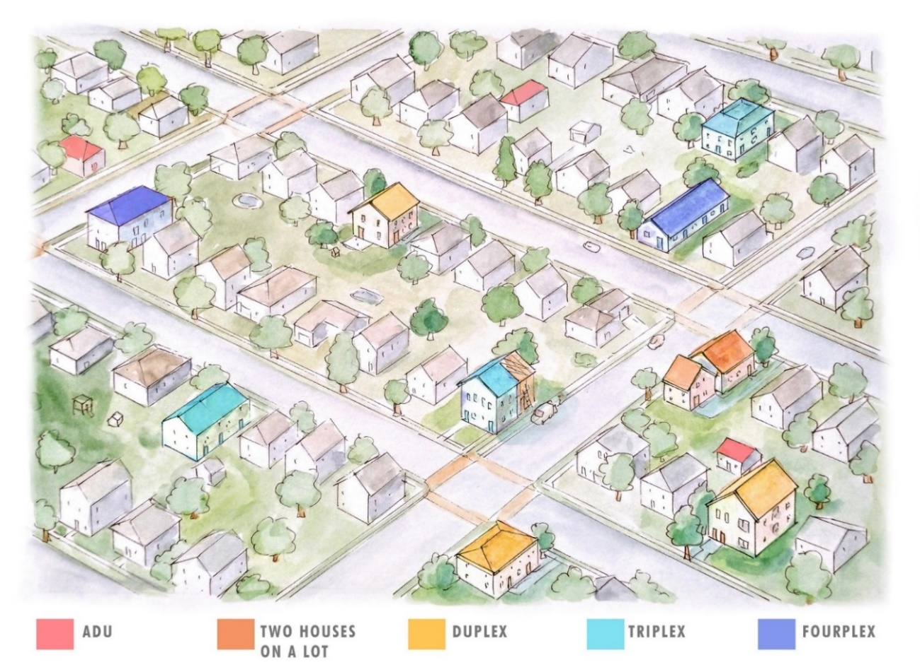
LTD promises gradual change
Based on multiple case studies, we estimate that around 2% of the single-family detached housing stock will be converted to a higher and better use through LTD per year.*
* The lower figures assumes a density of 2 units per lot and the higher figure assumes a density of up to 8 units per lot nationwide. These estimates are based on case studies are from Seattle, Charlotte, Houston, Palisades Park, and Tokyo.
Source: AEI Housing Center, www.AEI.org/housing.

Slide 15
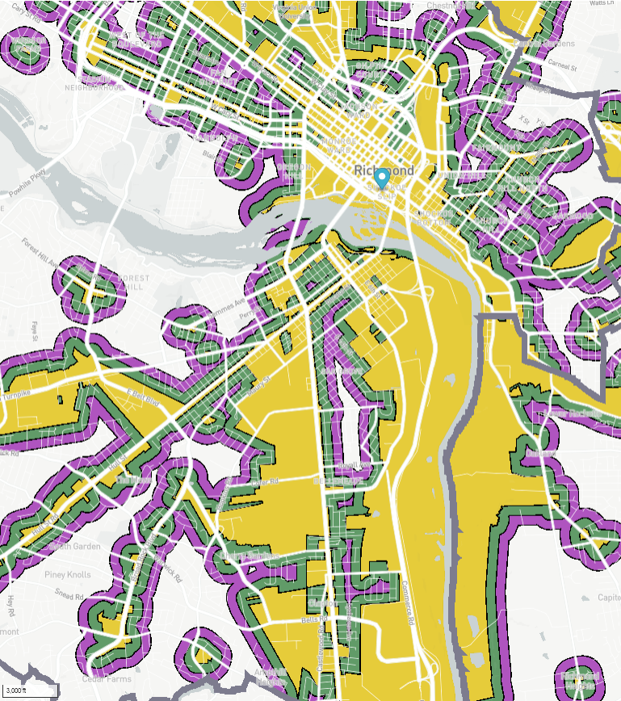
Livable Urban Villages (LUV) reduce sprawl, infrastructure costs, and energy use
Core areas: allow residential in commercial, industrial and mixed zones (gold): 5000 net new homes/year across Virginia
Adjacent areas: allow light-touch density in surrounding 1/8 mile (green) or ¼ mile (purple) areas. While there is minimal opportunity for infill tear downs due to low land shares, there are opportunities for ADUs/second units with no teardown.
Richmond
Suburban No. VA
https://heat.aeihousingcenter.org/toolkit/luv_map
Source: Zoneomics and AEI Housing Center, www.AEI.org/housing.

Slide 16
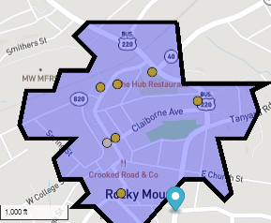
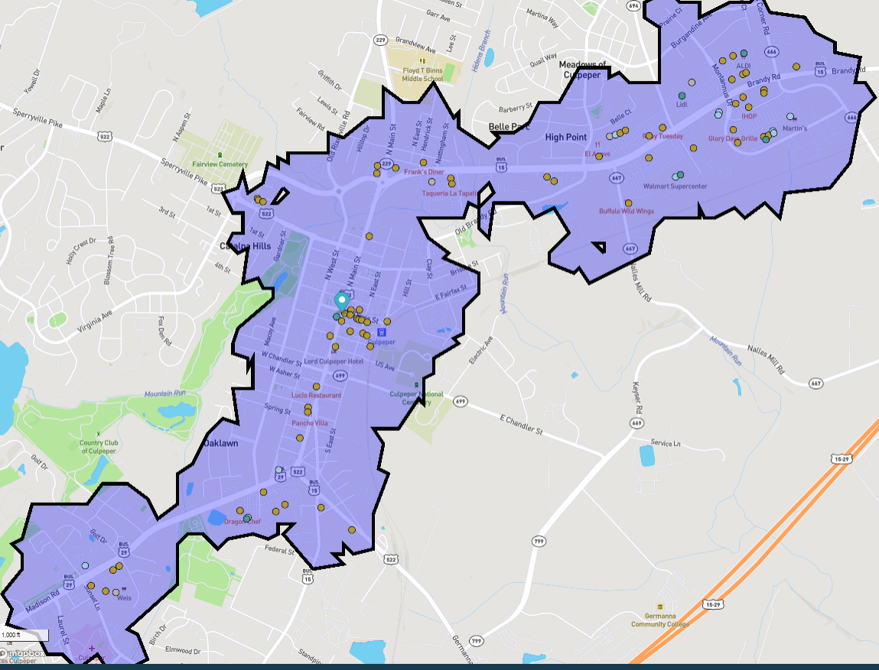
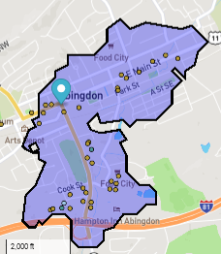
Walkable Oriented Development (WOD): a County Seat Strategy Would Reduce Sprawl, Infrastructure Costs, and Energy Use
* Nationally WODs contain about 20% of residential units, 85% of restaurants, bars, cafes, pharmacies, and supermarkets, 70% of hardware stores, and 60% of office space. On the map, WODs are denoted with thick black outlines and a blue tint. Each parcel within a WOD is within a 10-minute walk of a cluster of 6 or more points of interest. A cluster consists of at least 6 restaurants/bars, coffee shops, supermarkets/grocery stores, hardware stores, and/or pharmacies/drugstores. Ten minute walking isochrones (catchment areas of equal time) are calculated for each POI within a cIuster. WODs would bring housing closer to service jobs thereby reducing transportation and housing costs, while freeing up time for other activities such as recreation and child care.
Rocky Mount
Culpepper
Abington
WOD areas need to follow the Housing Abundance Success Sequence:
By-right zoning: up to 6-8 homes per parcel.
Keep it Short & Simple, including any tax abatement provided.
Source: Travel Time, SafeGraph, Mapbox, OpenStreetMap, & AEI Housing Center, www.AEI.org/housing, https://heat.aeihousingcenter.org/toolkit/wod

Slide 17
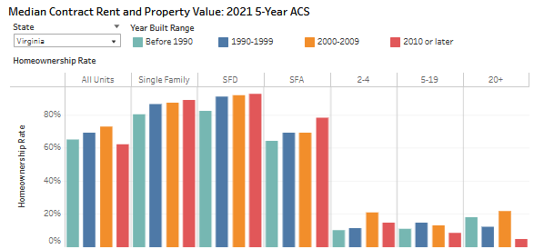
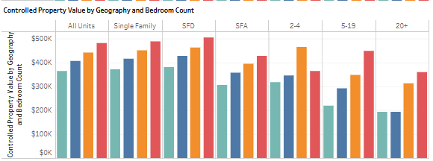
Light-touch density & Livable Urban Villages could help maintain Virginia’s 69.1% HO rate
VA homeowner (HO) rate is about 3 ppts. above the U.S. state average.
The left bar chart shows the HO rate by property type.
Only single-family detached (SFD) and attached (SFA) have high HO opportunity (93% and 78% respectively).
Multifamily properties with 20+ units have low HO opportunity (5%).
The right bar chart shows that newer SFAs are valued at 15% less than newer SFDs, and well below SFDs built from 2000-2009.
Only naturally affordable light touch density (LTD) offers both high HO opportunity and is more affordable.
This includes small lot SFD, SFA, twin and triplex homes, and individually saleable ADUs.
←High HO opportunity
←High HO opportunity
←Low HO opportunity
Newer SFAs valued at 15% less
than newer SFDs, & well below
SFDs built from 2000-2009.
* https://fred.stlouisfed.org/series/VAHOWN
Source: 5-year American Community Survey, https://www.propertyshark.com/info/us-homeownership-rates-by-state-and-city/, AEI Housing Center’s Housing and Economic Analysis Toolkit (HEAT) HO Rent Value ,AEI Housing Center

Slide 18
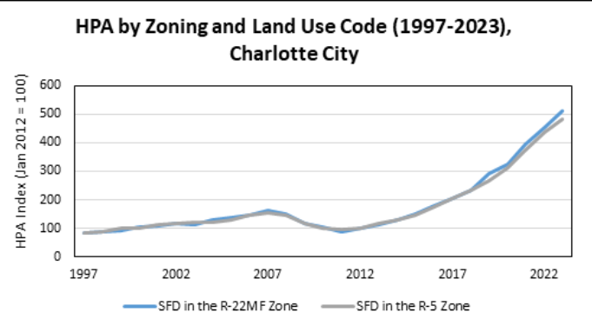
Charlotte, NC: Single-Family Detached Homes in R-22MF (LTD) Zones Appreciated over the last 37 Years at about the Rate as in R-5 (SFD) Zones
We compared home price appreciation for properties in R-22MF and R-5 zones across Charlotte city.
Sale records before 1997 are dropped due to low number-count.
The results show that SFDs in R-22MF zones (allows LTD) follow similar home price appreciation (HPA) trends to those in R-5 zones (SFD only).
We found similar results in Seattle.
These findings suggest that the allowing LTD homes doesn’t negatively affect HPA of SFDs in the area.
The
Source: AEI Housing Center, www.AEI.org/housing.

Slide 19
Housing Abundance Success Sequence
As numerous case studies from around the country have shown, the formula for successful housing reform is simple.
By-right zoning, which does not require approval from zoning boards or city or county councils,
Allow greater density in lots of areas particularly around walkable and amenity-rich areas through:
Light-touch density (LTD), which calls for modest density increases to areas zoned exclusively for single-family detached (SFD) homes. Particularly duplexes, triplexes, townhouses, and ADUs are compatible with SFD homes and therefore an easier political sell. At the same time, these housing types are smaller and require less land, which makes them more affordable to lower- and middle-income households, where the market need is greatest.
Livable Urban Village (LUV), which calls for mid- to high-density housing in underutilized commercial and industrial core areas, as well as LTD in adjacent areas.
Short and simple land use rules, fast permitting, and less expensive building standards.
Implementing these policies would unleash American ingenuity and enterprise by allowing builders of all sizes to build abundant market-rate housing over time thereby increasing the housing stock by about 2% per year.
Legalize and they will build!
List of case studies:
Anaheim
California
Charlotte
Cherry Creek & Denver
Fargo
Filtering: Theory and Practice
Houston
Institutional Landlords
Los Angeles
Los Angeles Metro: McMansionization
Minneapolis
Nashville (Study by Charles Gardner, Mercatus Center)
San Jose Metro
Palisades Park
Philadelphia
Phoenix & Arizona
Raleigh
San Diego ADU Construction
Sarasota
Sarasota: City & Livable Urban Villages
Seattle: Low-Rise Multifamily and Housing Supply
Short-Term Rentals
Single-Room Occupancy Units (SROs)
Tokyo
Traditional Housing Subsidy Programs and Inclusionary Zoning
Unleashing the Swarm
Utah
Vienna, Austria

Slide 20
Housing Abundance Success Sequence: 1. By-right zoning 2. Keep it short and simple (KISS) land use rules 3. Unleash housing
Link to AEI Housing Center Model Light-Touch Density Bill
Resolved: Abundant Housing and Less Sprawl for our Children & Grandchildren
Make These Avoid These
By-right Light-Touch Density (LTD) for infill development, preapproved plans | Exclusionary single-family zoning (designed and promoted by the federal government in 1922)
By-right LTD & tax abatement for derelict vacant lot infill | Making McMansions the highest and best legal use
Plentiful zoned land at a lower cost per home | Making land is scarce and expensive
By-right Accessory Dwelling Units up to 1500 - 2000 sq. ft. | Low maximum floor-area ratio
Small lot single-family detached greenfield LTD | High minimum lot size
Small lot single-family attached greenfield LTD | Income limits, affordable housing fees, & mandates
By-right lot splitting & home splitting (coliving) | Mandated inclusionary zoning
By-right residential zoning at higher density levels in Live Local Urban Villages (LLUV) | Rental bans or rent control
Zone sufficient land for green field LTD & LLUV | Owner-occupancy requirements
Light-touch permitting & processing, permit approval shot clocks, expand residential building code from 2 to 4/6 units | Impact fees; condominium liability laws/statutes of repose that set condo builder/developers for onerous litigation
Keep It Short and Simple (KISS) -- examples: Abolish or reduce minimum lot & unit size Reduce set-back requirements | Outsized parking or other requirements that increase construction costs or de facto prevent building LTD entirely (such as a low floor area ratio)
By-right zoning unleashes swarms of activity by property owners and small businesses | Anything not required for single-family homes
Say yes to abundant housing | Saying no to abundant and affordable housing
Good Neighbors support LTD | High displacement pressure & rates of homeless

Slide 21
Zoning: Virginia’s Declaration of Rights Provides a New Take on State vs. Municipal Powers
Rather than framing zoning as a power struggle between the VA legislature and municipalities, an alternative would be to frame as the citizens and the Virginia Bill of Rights on one side and the power of the government (both the legislature and municipalities) to limit those rights on the other side.
Relevant Constitutional Provisions, Article I: Virginia Bill of Rights (emphasis added):*
Section 1. Equality and rights of men. That all men are by nature equally free and independent and have certain inherent rights, of which, when they enter into a state of society, they cannot, by any compact, deprive or divest their posterity; namely, the enjoyment of life and liberty, with the means of acquiring and possessing property, and pursuing and obtaining happiness and safety.
Section 11. Due process of law;…taking or damaging of private property;…. That no person shall be deprived of his life, liberty, or property without due process of law;…That the General Assembly shall pass no law whereby private property, the right to which is fundamental, shall be damaged or taken except for public use. No private property shall be damaged or taken for public use without just compensation to the owner thereof. No more private property may be taken than necessary to achieve the stated public use. Just compensation shall be no less than the value of the property taken, lost profits and lost access, and damages to the residue caused by the taking.
Section 15. Qualities necessary to preservation of free government. That no free government, nor the blessings of liberty, can be preserved to any people, but by a firm adherence to justice, moderation, temperance, frugality, and virtue; by frequent recurrence to fundamental principles; and by the recognition by all citizens that they have duties as well as rights, and that such rights cannot be enjoyed save in a society where law is respected and due process is observed (see next slide).
Section 17. Construction of the Bill of Rights. The rights enumerated in this Bill of Rights shall not be construed to limit other rights of the people not therein expressed.
Framed in this manner, fundamental questions arise:
Do the Virginia legislature and municipalities have the power to prohibit their citizens from building an ADU or 2, 3 or 4 homes on a property of say 6000 square feet.
May they impose numerous expensive and burdensome non-health and safety related constraints present in today’s land use controls.
It is time to reexamine Virginia’s land use and planning laws that have evolved over the last one hundred years ago.
First, a recurrence to fundamental principles contained in Virginia’s Declaration of Rights.
Second, a recognition that time is of the essence in addressing Virginia’s affordability crisis and in implementing Virginia Housing Success Playbook.
* https://law.lis.virginia.gov/constitutionfull/

Slide 22
Background regarding Virginia’s Article I, Section 15 [Qualities necessary to preservation of free government.] That no free government, nor the blessings of liberty, can be preserved to any people, but by a firm adherence to justice, moderation, temperance, frugality, and virtue; by frequent recurrence to fundamental principles….
“America’s founders repeatedly counseled our nation’s citizens to study vigilantly the Constitution’s fundamental principles.*
George Mason in June 1776, writing the first Bill of Rights for the state of Virginia, said “no free government, or the blessing of liberty, can be preserved to any people but by … frequent recurrence to fundamental principles.” VA Decl.of Rights, Sec. 15 (1776).
Benjamin Franklin, just three months later, after the Declaration of Independence was signed, was equally clear in the Declaration of Rights for Pennsylvania: “a frequent recurrence to fundamental principles …is absolutely necessary to preserve the blessings of liberty, and keep a government free[.]” PA Const. of 1776, Decl. of Right No. 14.
Four years after that, John Adams, in his Massachusetts Bill of Rights of 1780, confirmed the point a third time: “a frequent recurrence to principles of the Constitution … is absolutely necessary to preserve the advantages of liberty and to maintain a free government.” MA Decl. or Rights, Art. 18 (1780).”
https://www.fedbar.org/wp-content/uploads/2021/10/Constitutional-Reflections.pdf

Slide 23
The Key Components in Virginia’s Housing Success Playbook

Slide 24
Policy 1: Smaller lot sizes

Slide 25
Shrinking single-family lot sizes: key component to Virginia’s Housing Success Playbook
The best time to fix the shortage and address affordability was 20 years ago, the second best time is today.
Virginia’s housing shortage would be non-existent today had housing been built at slightly higher densities.
Annually, 11,500 or 83% more SFD homes could have been built at 6.7 homes/acre (9th decile) vs. 3.7 homes/acre.
Annually, 22,000 or 160% more SFA and townhome (TH) homes could have been built with 80% of SFD homes at 6.7 homes/acre (9th decile) and converting the other 20% to TH at a density of 20 units/acre (median for TH).
These two steps alone would have increased the number of owner-occupied, family-sized residences built over 2000-2023 by 135% (from 308,200 to 723,000 homes).
Going forward, the smaller lot scenario (F) would double recent single-family permit levels to 45,000 annually.*
SFD homes built between 2000 and 2023 in Virginia: Scenario analysis for smaller lots
 | Baseline | Slightly Smaller Lots |  |  | If 20% of the SFD land at 3.7 homes/acre was instead used for townhomes (TH) at the median | If 80% of D. at 6.7 homes/acre and 20% at the median for townhomes (TH)
 | A. | B. | C. | D. | E. | F.
Density | 3.7 homes/acre median | 4.6 homes/acre 7th decile | 5.5 homes/acre 8th decile | 6.7 homes/acre 9th decile | 20.0 homes/acre median (TH) | 20.0 homes/acre median (TH)
Homes Built | 331,400* (Actual) | 412,300 | 491,600 | 596,500 | 623,000 | 835,100
Extra Homes (Cumulative) |  | 80,900 | 160,200 | 265,100 | 291,600 | 503,700
Extra Homes (per year) |  | 3,500 | 7,000 | 11,500 | 12,700 | 21,900
Sales price/GLA sq.ft. in 2023 | $545,300/2,780 (Actual) | $554,100/2,660 | $573,100/2,580 | $526,600/2,390 | $311,000/2,280 (TH only) compared to $359,600/1,770 (existing SFD stock)*** | $483,500/2,340 (All) compared to $359,600/1,770 (existing SFD stock)***
Owner Occupied** Homes (2010-2023) | 308,200 (Actual) | 383,400 | 457,200 | 554,700 | 525,700 | 723,000
* Over 2000-2023 SFD permits averaged around 13,800 homes per year. Over the last 5 years, Virginia has issued about 22,600 single-family permits per year. https://heat.aeihousingcenter.org/toolkit/housing_data_app.
** Based on 93% and 78% owner-occupied rates for SFD and TH respectively. Source: 2021 Five-year American Community Survey.
*** The sales price figure for scenario E is computed by multiplying the townhome-to-SFD price ratio (0.86) by the median sale price of the existing SFD stock.
Source: AEI Housing Center, www.AEI.org/housing.

Slide 26
Policy 2: Infill Light-touch Density

Slide 27
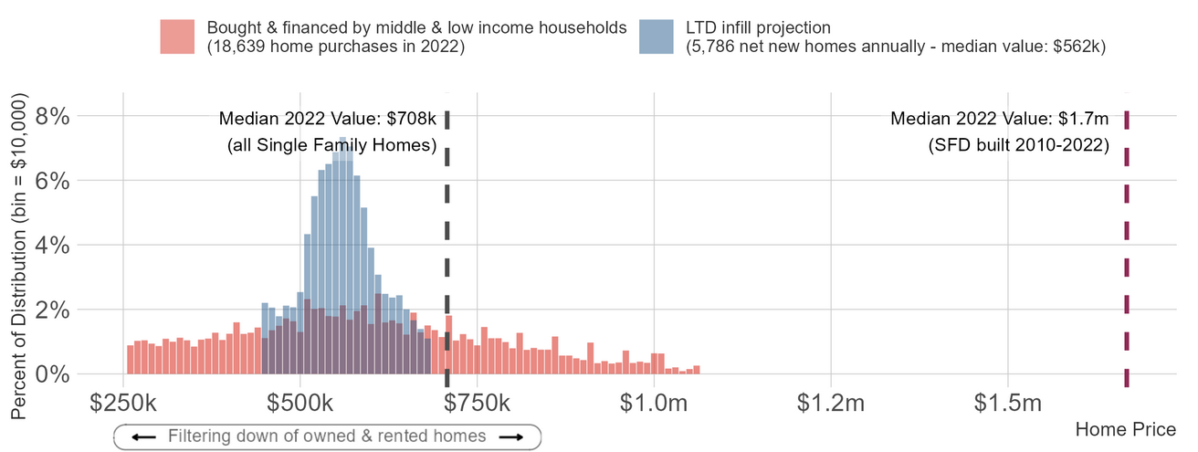
Fairfax County: Legalizing Light Touch Density infill will help create Housing Abundance by adding 5,800 net new homes annually with a median value of $562,000, which is 20% below the median value of its existing SF housing stock, and 67% below the median value of recently built SFD homes
https://heat.aeihousingcenter.org/ltd-chart

Slide 28
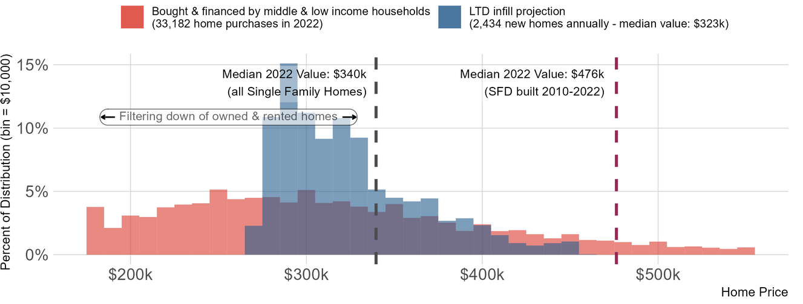
Richmond MSA: Legalizing Light Touch Density infill will help create Housing Abundance by adding 2,400 net new homes annually with a median value of $323,000, which is 5% below the median value of its existing SF housing stock, and 32% below the median value of recently built SFD homes
https://heat.aeihousingcenter.org/ltd-chart

Slide 29
Policy 3: Livable Urban Villages

Slide 30
Livable Urban Villages (LUV) reduce sprawl, infrastructure costs, and energy use
Core areas: allow residential in commercial, industrial and mixed zones (gold): 5000 net new homes/year across Virginia
Adjacent areas: allow light-touch density in surrounding 1/8 mile (green) or ¼ mile (purple) areas. While there is minimal opportunity for infill tear downs due to low land shares, there are opportunities for ADUs/second units with no teardown.
Richmond
Suburban No. VA
https://heat.aeihousingcenter.org/toolkit/luv_map
Source: Zoneomics and AEI Housing Center, www.AEI.org/housing.

Slide 31
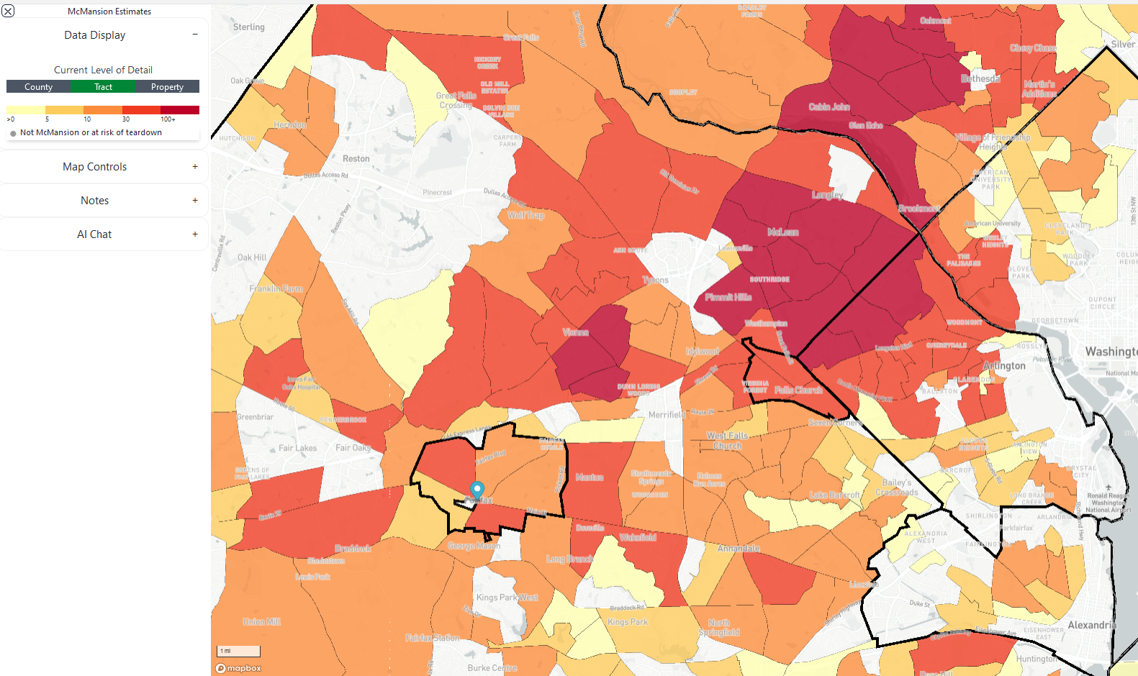
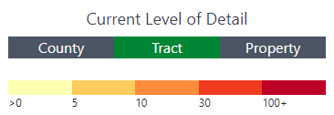
McMansionization is happening throughout much of Northern Virginia and the pace is quickening
The red and orange census tracts are where most of the McMansion conversions have been built over the last decade.
Source: AEI Housing Center, https://heat.aeihousingcenter.org/mcmansion-map.

Slide 32
Policy Steps in the Virginia Housing Success Playbook*
The Legislature should consider options to increase zoning density on a wide scale within the state.
Option 1: Light-touch density: greenfield subdivisions:
Provide that counties and municipalities may not establish a minimum lot size smaller than 4,356 sq. ft. (.10 acres) and 1,000 sq. ft. respectively for a newly constructed single-family detached (SFD) home and a newly constructed single-family attached (SFA) home.
Property owners may, by right, determine the mix of SFD and SFA homes for a particular parcel.
Projection: an additional 22,000 single-family greenfield permits per year.
Option 2: Light-touch density: infill with teardown
Provide that a small-scale subdivision is a by-right permitted use in a residential zone of an urban municipality.
A small-scale subdivision a subdivision of property that results in the creation of two or more lots, each of which:
Is no smaller than 1,400 square feet; and
Contains, or will contain, a single-family dwelling.
Projection: an additional 18,000 net new homes annually.
Option 3: Light-touch density: infill without teardown
Provide that an accessory dwelling unit, internal or external, is a permitted use if it is built:
In a residential zone of an urban municipality; and
On a lot that contains a primary residence or where a primary residence is being built concurrently with the accessory dwelling unit.
Projection: 15,000 ADUs annually (preliminary).
Option 4: Livable Urban Villages: core areas
Provide that residential development is a by-right permitted use in commercial, industrial, and mixed use zones of an urban municipality.
Projection: an additional 5,000 net new homes annually (preliminary).
These four steps would result in an additional 60,000 homes per year, an increase of 230% over recent levels.
*These projections assume the use of “Keep it short and simple” (KISS) land use rules.

Slide 33
Appendix

Slide 34
The Montana Miracle*
“As [Governor Gianforte] traveled throughout the state, county commissioners, sheriffs, business owners, and residents said the number-one issue for working families is affordability of housing.”**
The governor and the Legislature undertook “a series of sweeping reforms that included signing the pro-housing Montana Land Use Planning Act, overriding local zoning ordinances and enacting laws that will usher in more multifamily homes and accessory dwelling units. "Now, ADUs are legal everywhere in Montana," said Gianforte in a recent interview with Angela Brooks, FAICP, the president of the American Planning Association (APA). So, now a family that's on a fixed income living in a single-family home can rent out an apartment over the garage or in a basement. A nurse or a teacher can move in there and it's a starter apartment for them. It helps people on a fixed income make ends meet and it creates more dwelling units.”**
‘"We also changed the zoning law in Montana," he added. "Anywhere a single-family home is permissible, now a duplex is permissible.“’**
“Proposals put forward by a broad, bipartisan housing task force of state and city officials, planners, home builders, and nonprofit organizations were put into bills that received strong support in the Montana State Legislature. Taken together, observers dubbed it the "Montana Miracle" as this conservative, Republican-controlled state enacted progressive new housing laws, leaping ahead of some Blue states attempting to address the housing shortage.”**
Despite a recent Montana Supreme Court victory, litigation continues:***
The Montana League of Cities and Towns asked to join a pending case to help defend a land-use bill passed in 2023, saying it “could provide perspective to the court on how the act will work and how it benefit's Montana. “Our land use and planning statutes were written for a Montana a hundred years ago and could no longer be simply tweaked and amended to accommodate how we operate today,” said Kelly Lynch [the groups executive director]”
* https://deq.mt.gov/files/About/Housing/HTF_PhaseI_Final_10142022.pdf , https://deq.mt.gov/files/About/Housing/HTF_PhaseII_Final_12152022.pdf
** https://www.planning.org/planning/2023/fall/how-the-bipartisan-montana-miracle-confronts-the-housing-crisis-head-on/
*** https://missoulacurrent.com/land-use-bill/

Slide 35
Montana Miracle: Measures the Legislature Could Consider & the Governor Could Sign
https://deq.mt.gov/files/About/Housing/HTF_PhaseI_Final_10142022.pdf

Slide 36
Montana Miracle: Measures the Legislature Could Consider & the Governor Could Sign (cont’d)
https://deq.mt.gov/files/About/Housing/HTF_PhaseI_Final_10142022.pdf

Slide 37
Montana Miracle: Regulatory Changes and Best Practices that Could Be Adopted
https://deq.mt.gov/files/About/Housing/HTF_PhaseII_Final_12152022.pdf

Slide 38
Montana Miracle: Regulatory Changes and Best Practices that Could Be Adopted (cont’d)
https://deq.mt.gov/files/About/Housing/HTF_PhaseII_Final_12152022.pdf

